Slide 1







Deep Learning with Keras with TensorFlow

Slide 2
Artificial Neural Network

Slide 3

By the end of this lesson, you will be able to:
Explore neural networks
Perform weight updation using different activation functions
Deduce and implement backpropagation algorithm in Python
Optimize the performance of your neural network using L2 regularization and dropout layers

Slide 4
Biological Neuron vs. Artificial Neuron

Slide 5
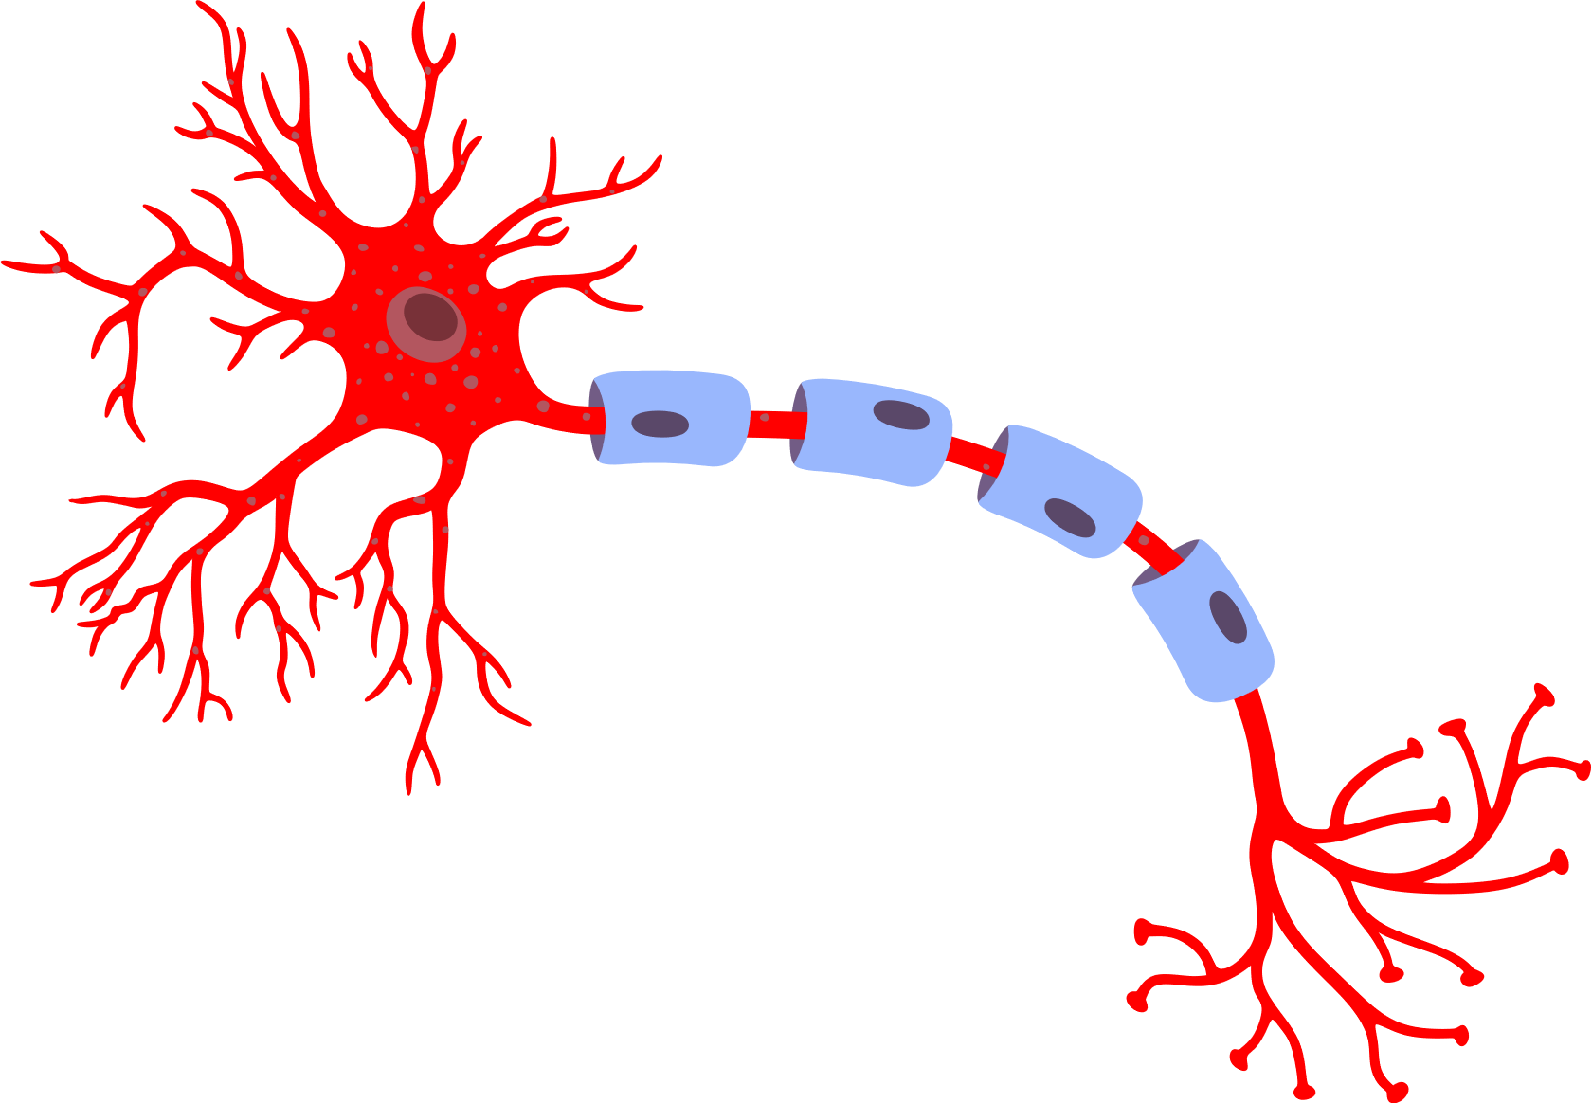
Biological Neurons
Myelin sheath
Dendrites
Axon terminals
Axon
Output Signals
Cell nucleus
Input Signals
Neurons are interconnected nerve cells that build the nervous system and transmit information throughout the body.
Dendrites are extension of a nerve cell that receive impulses from other neurons.
Cell nucleus stores cell’s hereditary material and coordinates cell’s activities.
Axon is a nerve fiber that is used by neurons to transmit impulses.
Synapse is the connection between two nerve cells.

Slide 6
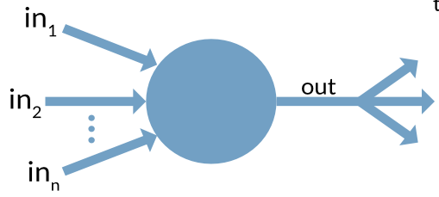
Rise of Artificial Neurons
Biological Neuron
Artificial Neuron
Researchers Warren McCullock and Walter Pitts published their first concept of simplified brain cell in 1943.
Nerve cell was considered similar to a simple logic gate with binary outputs.
Dendrites can be assumed to process the input signal with a certain threshold such that if the signal exceeds the threshold, the output signal is generated.

Slide 7


Definition of Artificial Neuron
An artificial neuron is analogous to biological neurons, where each neuron takes inputs, adds weights to them separately, sums them up, and passes this sum through a transfer function to produce a nonlinear output.

Slide 8
Biological Neurons and Artificial Neurons: A Comparison
Biological Neuron
Artificial Neuron
Biological Neurons
Artificial Neurons
Cell Nucleus
Node
Dendrites
Input
Synapse
Weights or interconnections
Axon
Output

Slide 9
Neural Networks

Slide 10
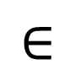
Perceptron
Single layer neural network
Consists of weights, the summation processor, and an activation function
Inputs
Weights
Net inputs
function
Activation
function
1
W₀
X₁
W₁
$$∈$$
Output
X₂
W₂
W_{n}
X_{m}

Slide 11
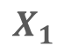

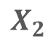
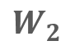
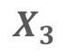

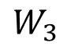
Perceptron: The Main Processing Unit
f (S)
S
Output
$$W_{3}$$
Summation Function
Activation
Function
Note: Inputs X and weights W are real values.

Slide 12
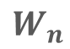
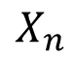
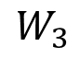
Weights and Biases in a Perceptron
While the weights determine the slope of the equation, bias shifts the output line towards left or right.
S
f (S)
Output
$$W_{3}$$
Summation Function
Activation
Function
$$X_{n}$$

Slide 13
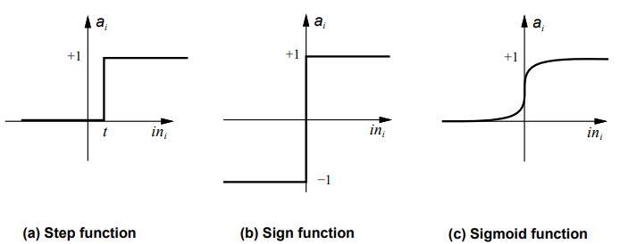
Activation Functions
Activation functions squash inputs to outputs by using a threshold value.

Slide 14
Feedforward Nets
Information flow is unidirectional
Information is distributed
Information processing is parallel

Slide 15
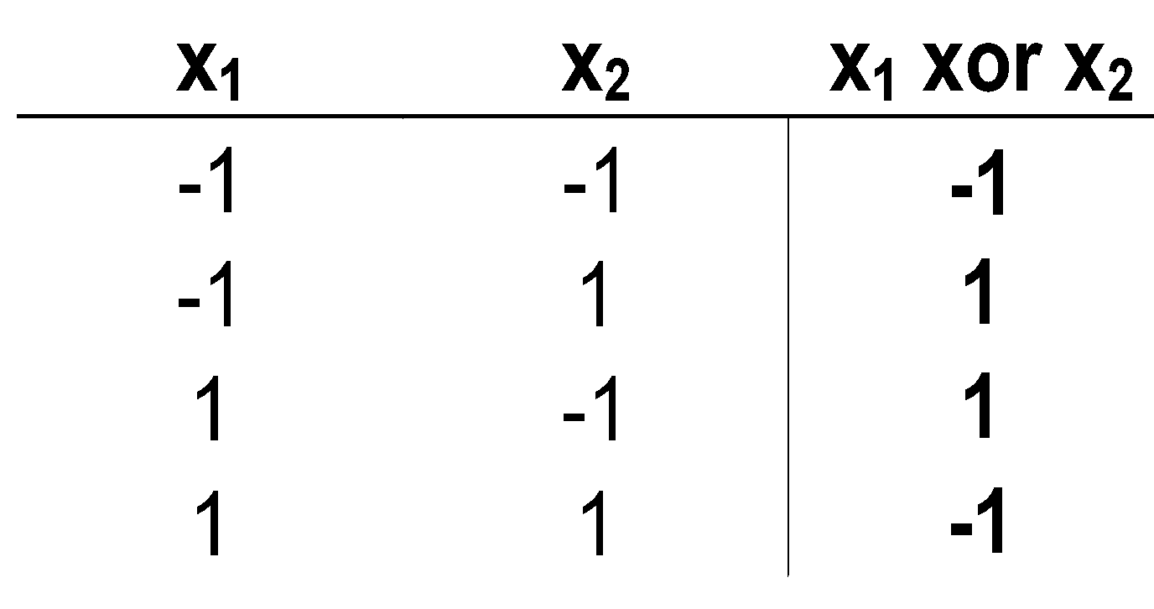
The XOR Problem
A perceptron can learn anything that it can represent, i.e., anything separable with a hyperplane. However, it cannot represent Exclusive OR since it is not linearly separable.
x₁
1
-1
1
x₂
-1

Slide 16
Multilayer Perceptrons
1
Ψ(a)
The most common output function(Sigmoid)
a
One or more layers of hidden units
(hidden layers)
Input nodes
Output neurons

Slide 17
Perceptron
Problem Scenario: You are hired by one of the major AI giants, planning to build the best image classifier model available till date. In the first phase of model development, the input is passed from the MNIST dataset. MNIST dataset is one of the most common datasets used for image classification and is accessible from many different sources. It is a subset of a larger set available from NIST and contains 60,000 training images and 10,000 testing images on handwritten digits taken from American Census Bureau employees and American high school students.
Objective:
Build a perceptron-based classification model to:
Classify the handwritten digits properly
Make predictions
Evaluate model efficiency
Access: Click the Practice Labs tab on the left panel. Now, click on the START LAB button and wait while the lab prepares itself. Then, click on the LAUNCH LAB button. A full-fledged jupyter lab opens, which you can use for your hands-on practice and projects.

Slide 18
Backpropagation

Slide 19
Learning Networks
Learn from the input data or from training examples and generalize from learned data
By training the network, it tries to find a line, plane or a hyperplane which can correctly separate two classes by adjusting weights and biases
The network configures itself to solve a problem

Slide 20
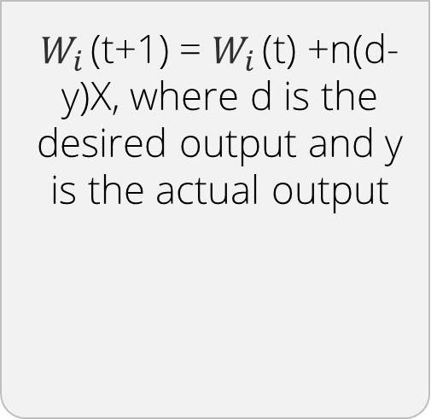
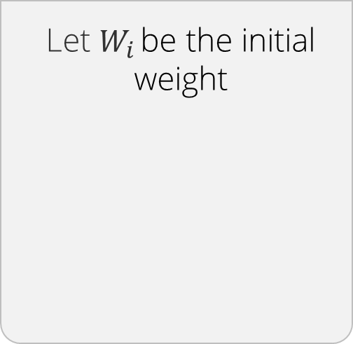
The Backpropagation Algorithm
Initialize the weights and the threshold
Provide the input and calculate the output
Update the weights
Repeat the initial steps
Let $W_{i }$be the initial weight
Let X be the input and Y be the output
$W_{i }$(t+1) = $W_{i }$(t) +n(d-y)X, where d is the desired output and y is the actual output
The former steps are iterated continuously by changing the values of n till a considerable output is obtained

Slide 21
The Error Landscape
The objective is to minimize the SSE (Sum Squared Error)
Error Landscape
SSE:
Sum Squared Error
S (t_{i} – z_{i})²
0
Weight Values

Slide 22
Deriving a Gradient Descent or Ascent Algorithm
The idea of the algorithm is to decrease overall error (or other objective function) each time a weight is changed.
Look at local gradient: the direction of largest change.
Take a step in that direction such that the step size is proportional to gradient.
Gradient descent tends to yield much faster convergence to maximum.

Slide 23
Gradient Ascent: Step 01
Initialize a random starting point
function
value
x

Slide 24
Gradient Ascent: Step 02
Take a step in the direction of the largest increase
function
value
x

Slide 25
Gradient Ascent: Step 03
Repeat
function
value
x

Slide 26
Gradient Ascent: Step 04
Next step is lower, so stop
function
value
x

Slide 27
Gradient Ascent: Step 05
Reduce step size to “hone in”
function
value
x

Slide 28
Gradient Ascent: Step 06
Converge to (local) maximum
function
value
x

Slide 29

The Learning Rate
Learning rate is used to control the changes made to the weights and biases in order to reduce the error.
It is used to analyze how an error will change when the values of weights and biases are changed by a unit.
Note: Generally, a learning rate of 0.01 is a safe bet.

Slide 30
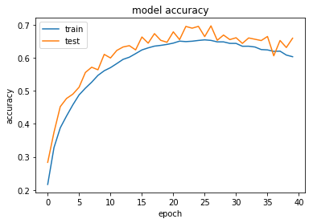
Epoch
One epoch consists of one full cycle of training data
Preferred value of number of training epochs is set to 1000

Slide 31
Backpropagation: Example

Slide 32
A Feed Forward Network
Consider a forward pass network
i1
.15 w1
h1
.40 w5
o1
.45 w6
.05
.20 w2
.01
.25 w3
.50 w7
i2
h2
o2
.30 w4
.55 w8
.10
.99
1
1
b1 .35
b2 .60

Slide 33
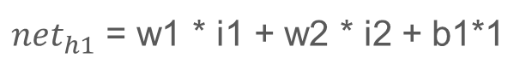
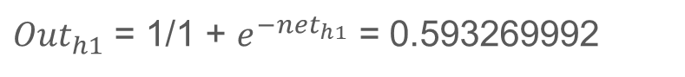
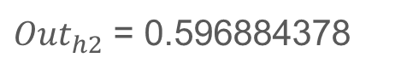
Forward Pass
Squash it using logistic function to get the output:

Slide 34
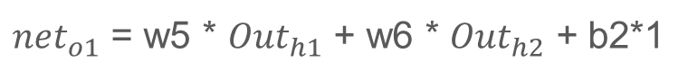
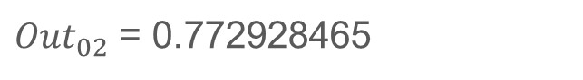
Forward Pass
Carrying out the same process for o2, we get:

Slide 35
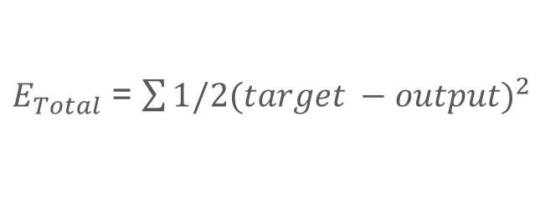
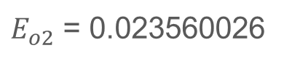
Calculating Total Error

Slide 36
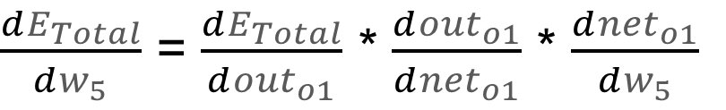
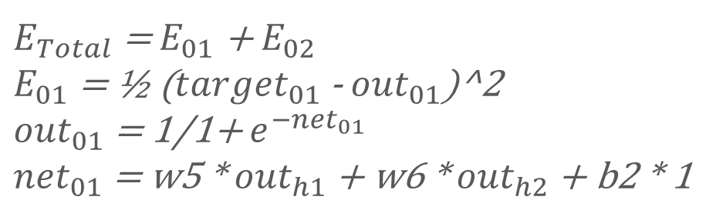
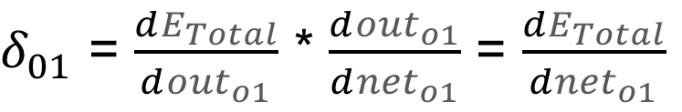
The Backward Pass
Let us consider $W_{5}$:

Slide 37
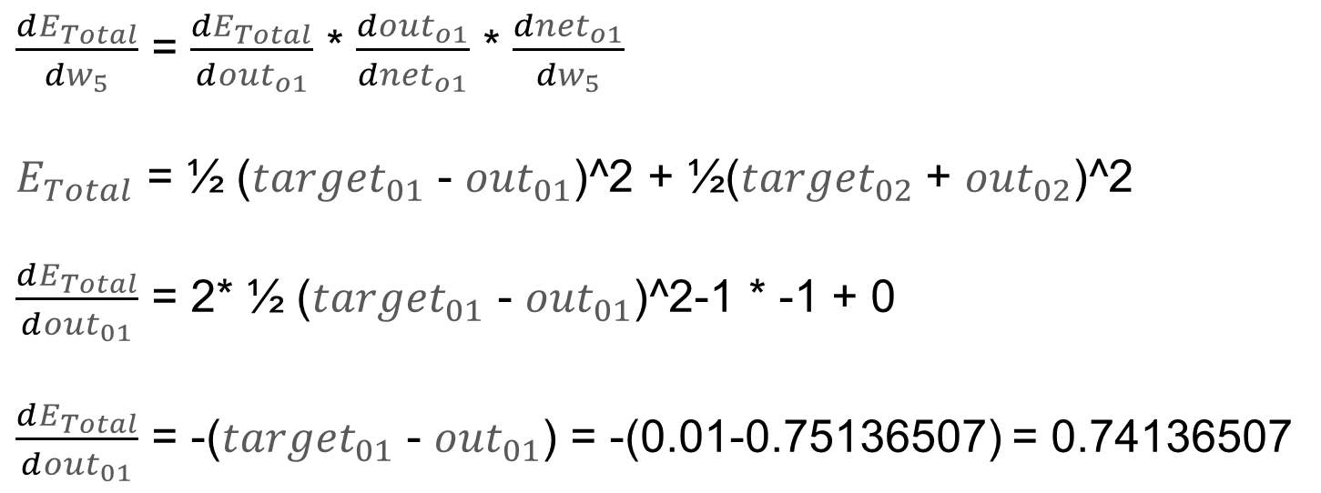
The Backward Pass

Slide 38
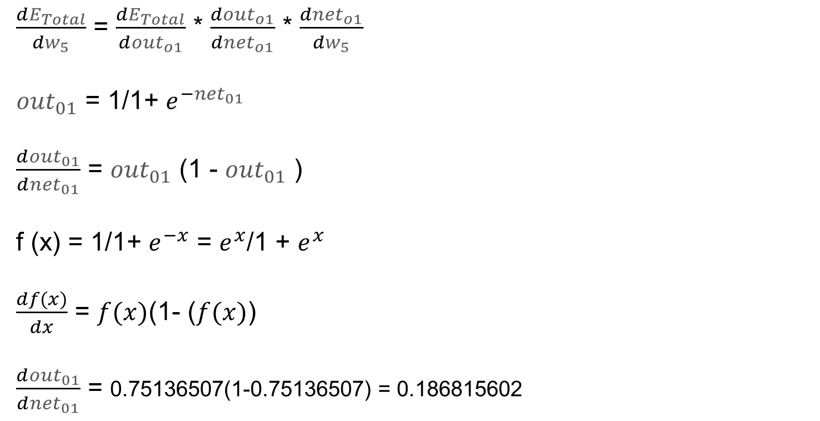
The Backward Pass

Slide 39
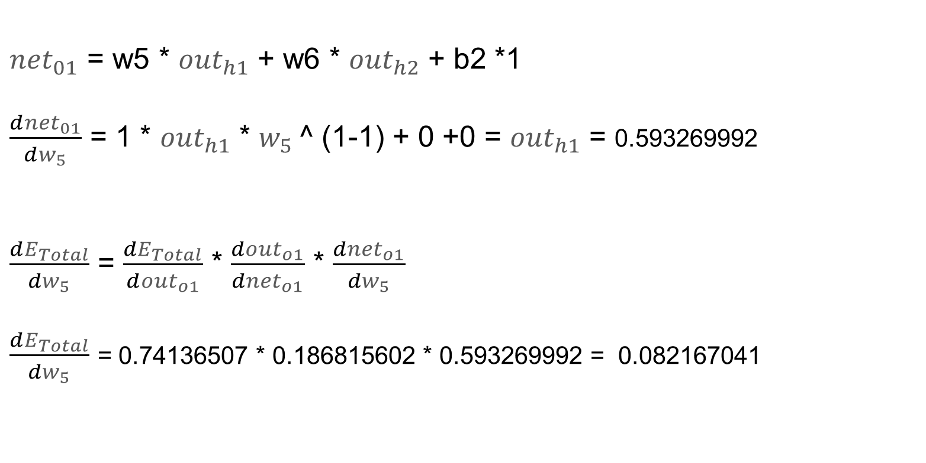
The Backward Pass

Slide 40
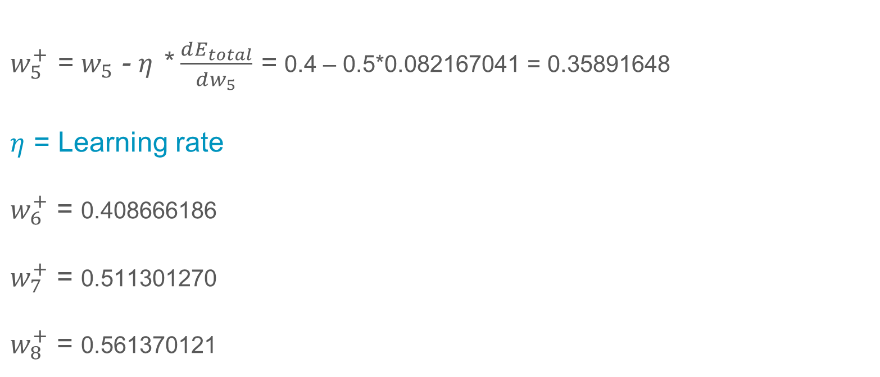
Weight Updation
Update the weight. To decrease the error, we then subtract this value from the current weight.

Slide 41
Weight Updation
i1
.15 w1
h1
.40 w5
o1
.45 w6
.05
.20 w2
.01
.25 w3
.50 w7
i2
h2
o2
.30 w4
.55 w8
.10
.99
1
1
b1 .35
b2 .60
Note: While using the backpropagation mechanism, we use the original weights, not the updated weights.

Slide 42



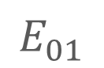
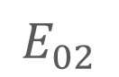
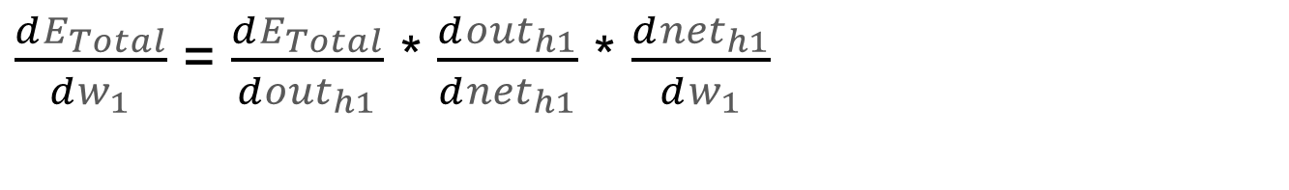
Hidden Layer Weight Assignment
i1
w1
net
out
h1
i2
h2

Slide 43
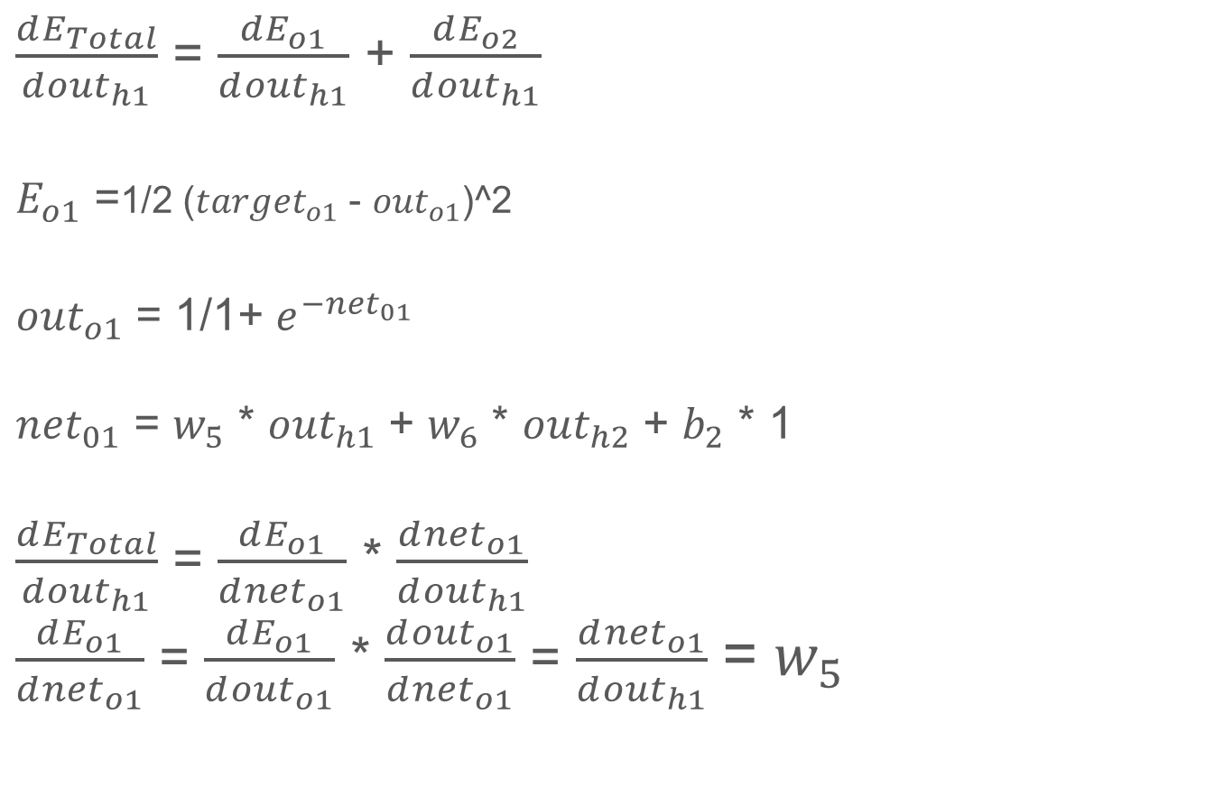
Hidden Layer Weight Assignment

Slide 44
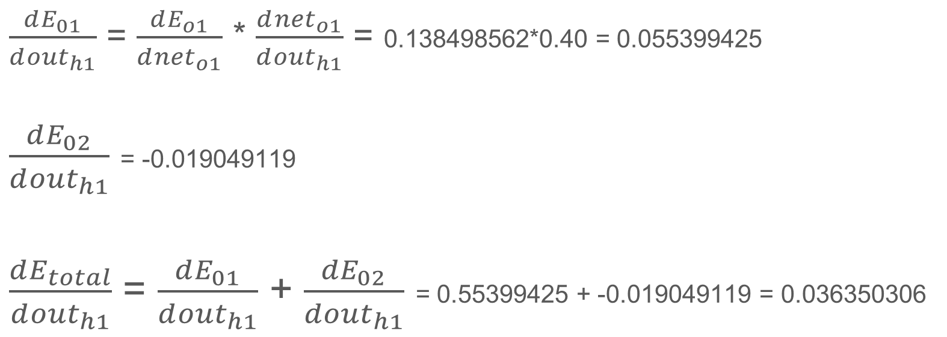
Hidden Layer Weight Assignment

Slide 45
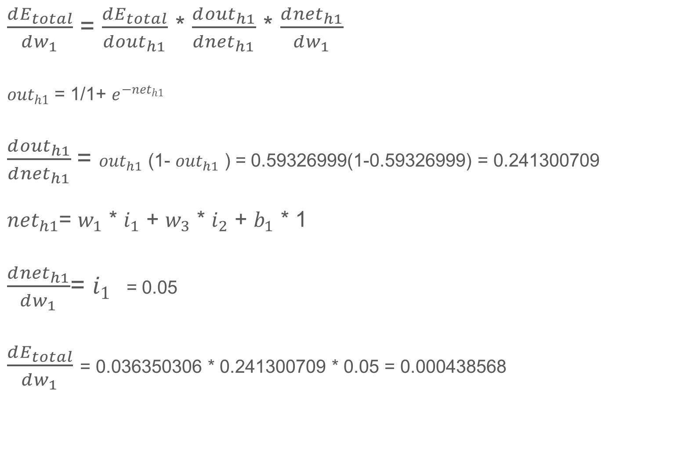
Hidden Layer Weight Assignment

Slide 46
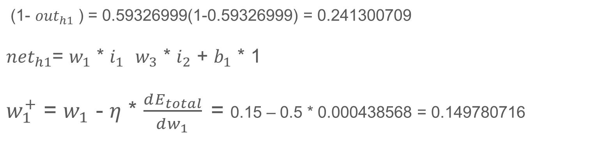
Hidden Layer Weight Assignment
$W_{1 }$can be updated now:
The same needs to be repeated for $W_{2}$, $W_{3}$, and $W_{4}$.

Slide 47
Initially the error was 0.298371109. However, post first iteration of the backpropagation algorithm the error value lowered down to 0.291027924.
The above error can be reduced significantly by repeating this process 10,000 times or more.

Slide 48
Activation Functions

Slide 49
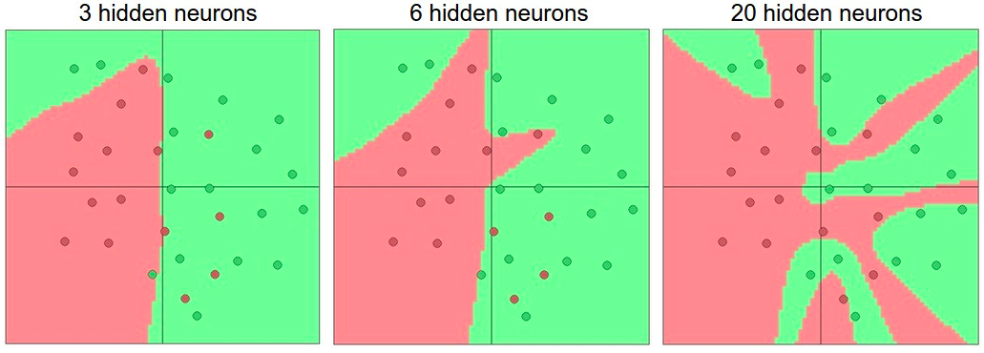
Activation Functions
Nonlinearities are needed to learn complex (non-linear) representations of data, otherwise the neural networks would be just a linear function

Slide 50
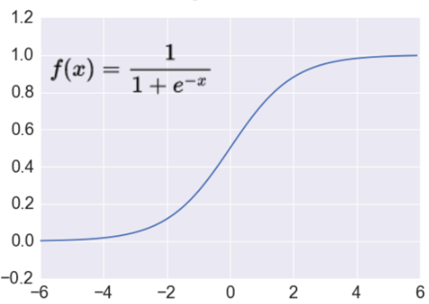
Activation Functions
Sigmoid
Tanh
ReLU
Takes a real-valued number and squashes it into a range of 0 to 1
Sigmoid neurons saturate and kill gradients, thus NN will barely learn

Slide 51
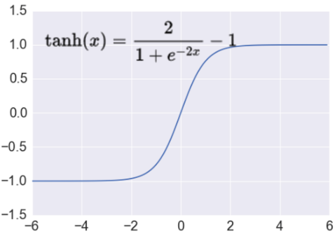
Activation Functions
Sigmoid
Tanh
ReLU
Takes a real-valued number and squashes it into a range of -1 to 1
Like sigmoid, tanh neurons saturate
Unlike sigmoid, output is zero-centered

Slide 52
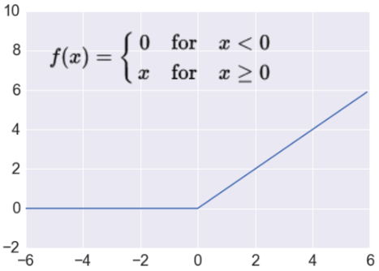
Activation Functions
Sigmoid
Tanh
ReLU
Takes a real-valued number and thresholds it at zero
Most deep networks use ReLU nowadays
Trains much faster
Prevents the vanishing gradient problem

Slide 53
Backpropagation
Problem Scenario: The backpropagation algorithm plays a key role in training a feedforward artificial neural network. It models a given function by modifying internal weights of input neurons to produce an expected output neuron.
Objective:
Build a neural network which takes tanh as the activation function and updates weights with respect to the tanh gradients.
Access: Click the Practice Labs tab on the left panel. Now, click on the START LAB button and wait while the lab prepares itself. Then, click on the LAUNCH LAB button. A full-fledged jupyter lab opens, which you can use for your hands-on practice and projects.

Slide 54
Activation Function
Problem Scenario: Neural networks are the crux of deep learning, a field which has practical applications in many different areas. They become more accurate and effective with multiple layers. The creation of multilayered neural network is not feasible. However, developing the source code for a shallow neural network will help understand the functioning of deep neural networks much better.
Objective: Write a simple neural network in Python considering the activation function as sigmoid.
Access: Click the Practice Labs tab on the left panel. Now, click on the START LAB button and wait while the lab prepares itself. Then, click on the LAUNCH LAB button. A full-fledged jupyter lab opens, which you can use for your hands-on practice and projects.

Slide 55
Defining Elements
Import the necessary libraries and define a class in the name of NeuralNetwork

Slide 56
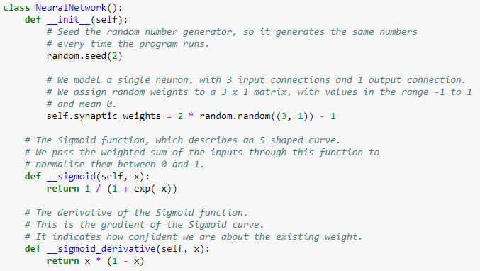
Initialize Weights and Assign Activation Functions

Slide 57
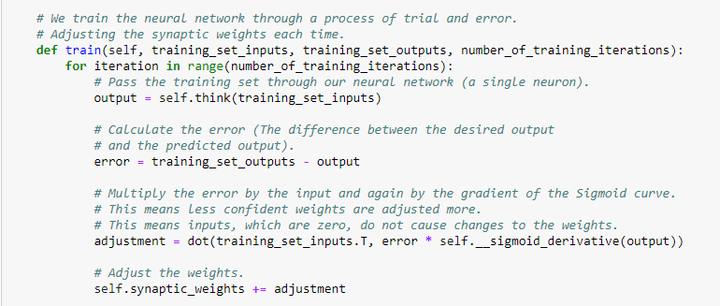
Weight Adjustment
Note: The above functions are defined within the class named NeuralNetworks.

Slide 58
Weight Adjustment
Note: The above functions are defined within the class named NeuralNetworks.

Slide 59
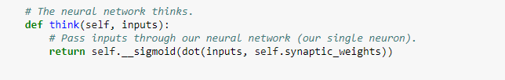
Initialize the think Function

Slide 60
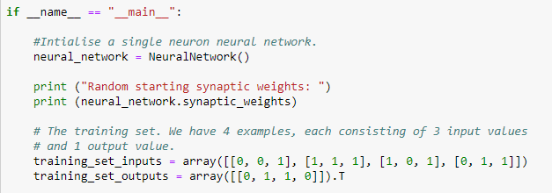
Initialize the Neural Network

Slide 61
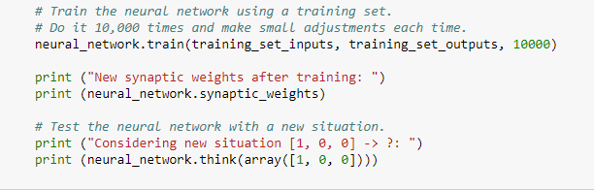
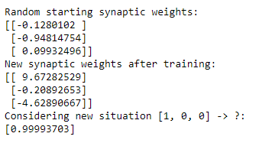
Train the Neural Network

Slide 62
Regularization

Slide 63
Deep Neural Networks
When a neural network contains more than one hidden layer it becomes a Deep Neural Network.
……
……
……
Input layer
Output layer
Multiple hidden layers

Slide 64
The Overfitting Problem
Training data
Validation data
error
Starting to overfit
Early stopping algorithm
Epochs
Learned hypothesis may fit the training data and the outliers (noise) very well but fail to generalize test data.

Slide 65
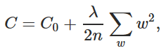
Dealing with the Overfitting Problem
Regularization penalizes big weights, in addition to the overall cost function
Weight decay value determines how dominant regularization is during gradient computation
Big weight decay coefficient implies big penalty for big weights
L2 Regularization
Dropout Regularization
Regularization term
Squared Weights

Slide 66
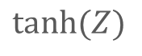
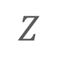
Dealing with the Overfitting Problem
L2 Regularization
Dropout Regularization
Complex nonlinearity reduced to linear function after application of L2 regularization, thus reducing the complexity due to hidden layers

Slide 67
Dealing with the Overfitting Problem
L2 Regularization
Randomly drops units (along with their connections) during training
Each unit is retained with fixed probability p, independent of other units
0 < p < 1
Hyper-parameter p has to be chosen (tuned)
While testing the entire network gets activated while the weights get scaled by a factor of p
Dropout Regularization

Slide 68
Dealing with the Overfitting Problem
L2 Regularization
Dropout Regularization
Dropout Layers

Slide 69




Dropout Experiment
An architecture of 784-2048-2048-2048-10 is used on the MNIST dataset. The dropout rate 𝑝 was changed from small numbers (most units are dropped out) to 1.0 (no dropout).
High rate of dropout ($p<0.3$)
Underfitting
Very few units are turned on during training
No dropout ($p=1.0$)
Training error is low
Test error is high
Best dropout rate ($p=0.5$)
Training error is low
Test error is low

Slide 70
Now, you are able to:
Explore neural networks
Perform weight updation using different activation functions
Deduce and implement backpropagation algorithm in Python
Optimize the performance of your neural network using L2 regularization and dropout layers

Slide 72
After the perceptron algorithm finishes training, how can the learned weights be expressed in terms of the initial weight vector and the input vectors?
1
It requires one bit per data point
It requires one integer per data point
It requires one real number per data point
It is impossible

Slide 73
After the perceptron algorithm finishes training, how can the learned weights be expressed in terms of the initial weight vector and the input vectors?
1
It requires one bit per data point
It requires one integer per data point
It requires one real number per data point
It is impossible
b
During the perceptron training algorithm, the weights are updated by adding or subtracting the input vector. Moreover, this might happen multiple times for the same input vector. Therefore, the weight vector = initial vector + c1 * data point 1 + c2 * data point 2 + … cn * data point n, where c_i = number of times data point i was added - number of times data point i was subtracted

Slide 74
Which of the following techniques performs similar operations as dropout in a neural network?
2
Bagging
Boosting
Stacking
None of these

Slide 75
Which of the following techniques performs similar operations as dropout in a neural network?
2
Bagging
Boosting
Stacking
None of these
a
Dropout can be seen as an extreme form of bagging in which each model is trained on a single case and each parameter of the model is very strongly regularized by sharing it with the corresponding parameter in all the other models.

Slide 76
MNIST Image Classification
Problem Scenario: The MNIST dataset is widely used for image classification. However, while validating the same, researchers found out that the classification model was overfitting as it was not giving acceptable accuracy on the testing data.
Use the mnist_test.csv and mnist_train.csv for model optimization (using dropout layers). Also, you will have to use one hot encoding for training and testing labels.
Objective:
Optimize a neural network based classification model using dropout regularization such that the p value is 0.70 for input and hidden layers.
Access: Click the Practice Labs tab on the left panel. Now, click on the START LAB button and wait while the lab prepares itself. Then, click on the LAUNCH LAB button. A full-fledged jupyter lab opens, which you can use for your hands-on practice and projects.

Slide 77
Thank You

